Slide 1
Introduction to Information Technology and AWS Cloud

Slide 2
Introduction
It Foundational knowledge
  Solid State drive uses flash memory to store and retrieve data
  Hot Swap – Replace Hard Drives
  Server - A machine to perform tasks non-stop
  Latency – Amount of time the data travels from one computer to another
  VPN
    Function: Mask your privacy
    Function: Restricts the network perimeter, isolates networks and provides secure remote access
      Encrypts traffic between two networks
    Client to Site VPN
    Site to Site VPN : established a secure connection between two or more physical locations ( sties )
  Key Components of an operating systems
    Functions
      Memory Management – Allocates and Deallocates memory space
      Process Scheduling
      Device Drivers
      Interrupt Handling – signals that devices send to get the attention of the OS

Slide 3
Introduction
Threads
  Share same memory space and resources
  enable concurrent execution
  enable multitasking within a single program
Processes
  enable multiple processes running at the same time
Virtualization
  Isolate and manage multiple workloads
  Virtual software mimics the functions of physical hardware to run multiple virtual machines
  Other Types
    Server Virtualization – Partitions a physical server into multiple servers. Virtualization allows the whole machine to be used
    Containerization vs Storage Virtualization
      Deploy application code to run on any physical environment without changes
      Bundles the application code/libraries/configuration files and other dependencies

Slide 4
Introduction
Storage Virtualization
  Network attached Storage (NAS)
  Storage Area Network (SAN)
  Pool storage hardware to create large unit of virtual storage that can be controlled and assigned
  stream line archiving, backup, recvery
Network Virtualization
  Combines all network resources to centralize administrative tasks
  Administrator can adjust and control these elements virtually without touching the physical components which simplifies network management
  Approaches
    Software Defined Networking – Controls traffic routing by taking over routing management from data routing in the physi8cal environment
      Ex. Company wants to provide consistent call quality in online meeting – Can program System to prioritize video-call traffic over application traffic
    Network Function Virtualization – Improve network performance by combing the functions of network appliances such as firewalls, load balancers and traffic analyzers
Data Virtualization – Create a software layer between the data and the application to allow the data to be returned in the correct format and clean.
Application Virtualization – Run applications on an OS that it was not meant to be
Desktop Virtualization – ???
Hypervisor – Manages virtual machines – Sites between the physical machine and the virtual to make sure resource are allocated and deallocated correctly

Slide 5
Introduction – Networking
Web Server – Designed to respond specifically to web request such as http or https usually serves static content
  Examples of Web Servers
    Apache HTTP Server
    NGINX
Web Application Server – Software Frameworks that provide an environment and libraries for building and running web applications
  provide database connectivity, business logic and session management
  Example
    Tomcat
    Jboss
Fleet – Grouping of servers all used for the same purpose
  Send the request to a load balancer which sits in front of a fleet
  Ports
    80 HTTP
    443 HTTPS
    22 SSH
    53 DNS
    21 FTP
SSL is a protocol that is used for encrypting network traffic and ensuring secure communication over the internet.

Slide 6
Introduction
Layered Architectures
  N tier architectures
  Found in monolithic applications
  Split into Front End, Application and Database Layer
Basic Terms
  Authentication – Are you who you say you are
  Authorization – Giving users permission to resources and services

Slide 7
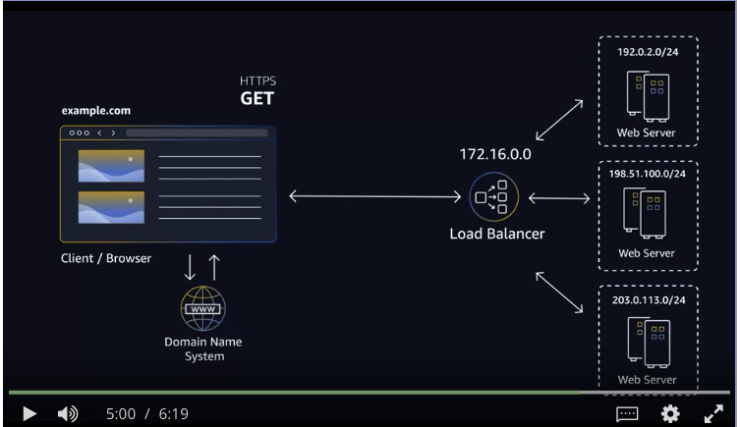
Introduction
What happens when I load a website from a browser
  Packets – A small unit of information sent over a network from one device to another
    Go through the router
    Go through the ISP
    Go through the internet exchange hub – where different ISP and networks connect and exchange network traffic
  After the browser find s the server on the internet a TCPIP/connection with the server
    HTTPS requires a TLS handshake
    Then the content of the page is retrieved

Slide 8
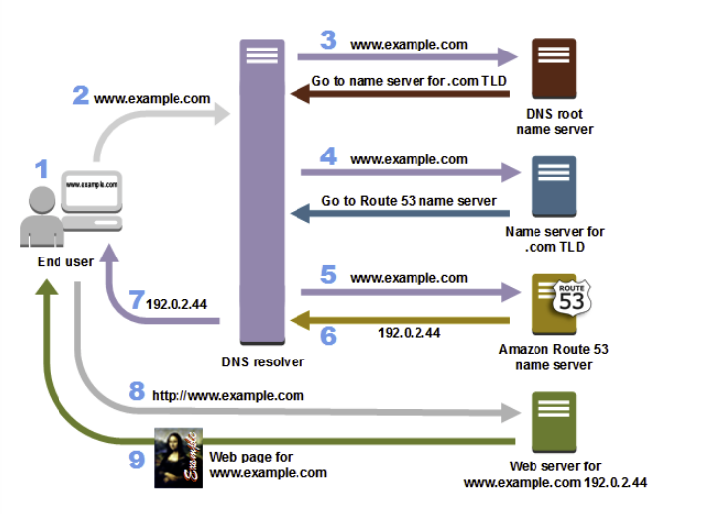
Introduction
DNS Basics
  DNS Lookup : Translate part of an URL into a record
  DNS record types
    A: Address Record
    AAAA: Ipv6 address record
    MX: Mail exchange record
    CNAME: Canonical name record ( Maps to another name )
    TXT: map to any text you might want.
Command line tool : nslookup -typeA evn.raflopes.com.br
www is a subdomain for a hosted web site
  each text before period in address is a subdomain
port 53 DNS Services
queries When the user enter a domain name into the browser
  Step 4 – Go to a top leve domain fro .com domains which response with four Route 53
  Ip addresses
  Step 5 – The DNS resolver for the ISP choose an Route 53 name server and forwards the url to that server

Slide 9
Introduction
IT Security Basics
  Benefits of removing credentials from code
    Protect if code is leaked
    include refined security controls
    Logging and compliance
    Credential Rotation
  AWS Secrets Manager – Create passwords and store them
Encryption in Transit and Rest
TLS – update version of SSL
  TLS – Data encrypted with a TLS Certificate ( configure encryption in transit )
DNS Caching
  When you use a cache each piece of data gets a Time to Live (TTL)
  caching is used to reduce latency when data is retrieved

Slide 10
Introduction
How Http works
  When you connect to a website with HTTPS, your browser requests a secure connection.
  The website's server responds by sending its SSL/TLS certificate, which contains a public key.
  Your browser checks if the certificate is valid and trustworthy, and that the website is what it claims to be.
  If the certificate is valid, your browser generates a random encryption key and encrypts it by using the server's public key. Only the server can decrypt this by using its private key.
  At this point, your browser and the server share a secret encryption key, which is known as a session key. All the data that’s exchanged between your browser and the server is encrypted by using this session key.
  Encrypted data is sent back and forth securely, which protects your information from being intercepted or tampered with. Encrypted data is not human readable, and only someone with the session key can decrypt the data to read it.
  The browser receives the encrypted data and uses the session key to decrypt it, so that the website's content can be rendered and be made human readable.
A resource refers to information that can be accessed through a Uniform Resource Locator (URL).
  A resource in this context can be a webpage, an image, a document, or any other digital content that can be requested or manipulated through HTTP.

Slide 11
AWS Public Cloud Component
What are APIs and Elasticity is common
IT Job Roles and the Cloud
Cloud Consulting ideas and how to get involved
VPC
  private networking space in AWS to host components (EC2, Load Balancers)
  Define the range of private IP addresses for your VPC : Stop at 3:11
What are API and Elasticity is common
  EX. : Web Console does API calls and are always authenticated and encrypted
  Elasticity – Easily Resizable
IT Job Roles and the Cloud
Cloud Consulting Ideas and how to get involved
  AWS Well Architected Framework is a set of best practices when working with cloud environments
AWS handles the undifferentiated lifting

Slide 12
Security

Slide 13
AWS Global Infrastructure
See notes from AWS.odp
Covered Availability Zones
AWS Region Consideration
  Compliance
  Latency How close AWS Resource are to your computers
  Pricing
  Serviceability
Edge Location and Regional Edge Caches
Example name ;us-east-1 would be a region us-east-1a would be an availability zone
Scope of AWS Services
  May be AZ, Region or Global Level
  For Region scoped AWS will perform actions to increase data durability and availability
  For Availability Zone AWS will not perform actions to increase data durability and availability
Use Region scope managed services come with availability and resiliency

Slide 14
Interacting with AWS
See AWS.odp
AWS Command line Interface
  Download and use terminal on screen
  CloudShell

Slide 15
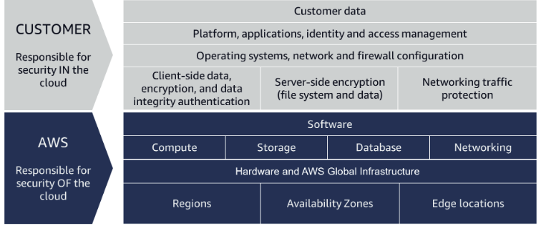
Security and the AWS Shared Responsibility Model
See AWS.odp
Global Infrastructure – The infrastructure that AWS runs on.
AWS handle security up to and including the virtualization layer
The customer is responsible for security in the cloud
  patching the OS
  encrypting data
  controlling who has access to the data
  etc.
You own your data and are responsible for your data being encrypt and who views it
  native features can be used.
  may device your own solutions to meet compliance and security standards
A customer is responsible for security in the cloud, while AWS is responsible for security of the cloud. For more information, see the Security and the AWS Shared Responsibility video.

Slide 16
Protect the AWS Root User
The email address that you sign up with becomes the root user
  Has two set of permissions:
    username/password use to create the account
    access keys which allow programmatic requests
      Access keys consist of two parts – need both to authenticate the user
        An access key id
        A secret access key
The root user has all the powers that can be had.
Protect the Root User
  Create a very complicated password
    Single Factor Authentication
  Best Practice –
    Enable MFA
      Example Phone APP to generate a one time password
    Do not use the root user for your everyday tasks
    Never share your root user password or access keys with anyone
    Disable or delete the access keys associated with the root user

Slide 17
Protect the AWS Root User
  Assign Least Privilege
  Regularly review and update IAM policies to minimize unnecessary access
  Rotate Access Keys
    If you're using AWS access keys for programmatic access (e.g., AWS CLI or SDKs), regularly rotate them.
    Use IAM roles with temporary credentials whenever possible to reduce the need for long-lived access keys.
  Enable CloudTrail Logging
    AWS CloudTrail logs API activity in your AWS account. Enable it to monitor and track user activity.
    Store CloudTrail logs in a secure S3 bucket and restrict access to the bucket.
  Use AWS Identity and Access Management (IAM) Roles:
    Instead of using long-term access keys, assign IAM roles to EC2 instances, Lambda functions, and other AWS resources.
    Roles provide temporary credentials and can be more secure.
  Implement AWS Organizations:
    AWS Organizations helps you centrally manage multiple AWS accounts and apply security policies consistently across them.=
    Create a consolidated billing account and separate accounts for different purposes (e.g., production, development, testing).
  Use AWS Trusted Advisor or third-party security tools to identify and remediate security issues.
  Use AWS Secrets Manager or Parameter Store
  For managing sensitive information like database passwords or API keys, consider using AWS Secrets Manager or Systems Manager Parameter Store, which can securely store and rotate secrets.
Authorization
  Single Factor Authorization – Username/password
  The second or third could be a pin number, one time password, bio

Slide 18
Introduction to AWS Identity and Access Management
Access Control
  Manager how user login and use the application (username /password )
    Access Management on the application level.
    IAM is not used for website authentication or authorization ( ex. website sign-in and sign up)
      Does ot support security control for protecting security control or OSs
  Make calls to the S3 – Must be signed and authenticated
  There are two groups here : Users and Developers ( ex. access S3 and create the algorithms )
    Have Unique credentials for each group
  When creating a user – must click on enable console access to allow the console to be able to display the user
Use IAM to create the user which takes care of authentication
Authorization
  Permissions control what you can and cannot do
  Attach IAM polices to grant or deny permission
Service : AWS Identity and Management
  Manage Login and permissions
  Manage the credentials used to Sign API calls made to AWS Service
  Integrated with many AWS Services – https://docs.aws.amazon.com/IAM/latest/UserGuide/reference_aws-services-that-work-with-iam.html

Slide 19
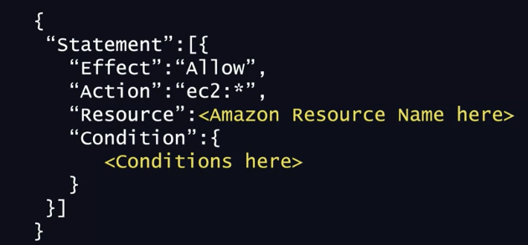
Introduction to AWS Identity and Access Management
  support Identity Federation
    Allows users who already have password elsewhere
    to get temporary access to your AWS Account
  Not be responsible for application Access Management
  – close to 3:30 may need to research
  Allows you to create users
  Authorization
    Attach IAM Policies to an AWS Identity
      Grant or deny permission sto take actions
        Actions are AWS API Calls
      JSON Documents
      Can attach a policy to a group or user
  IAM is global and not specific to a region
  Best Practice: Organize user in a group and assign permission
  to the group
  Best Practice: Create an IAM User with admin permissions.
Group can have many user and many users can have many groups and groups cannot belong to groups
First line above the { must be version with a data ( format: yyyy-mm-dd ).
ec2:* is a wildcard and Resource can have wilds to

Slide 20
Introduction to AWS Identity and Access Management
Example of the Administrator policy
  {
  "Version": "2012-10-17",
  "Statement": [{ "Effect": "Allow", "Action": "*", "Resource": "*" }] }
Example of letting the user change his own password and get information about himself
  "Statement": [{
  "Effect": "Allow", "Action": [ "iam: ChangePassword", "iam: GetUser" ]
  "Resource": "arn:aws:iam::123456789012:user/${aws:username}"
  }] }
AWS Managed Policy – The policy is created and managed by AWS
Custom Policy – Use to create more restrictive access

Slide 21
Role Based Access in AWS
IAM Role is an identity can be assumed by a user or a resource that needs temporary access to AWS Credentials
IAM Roles have identity just like IAM_USERS,
  Do not have user names and passwords
  credentials to sign requests are programmatically required
    temporary in nature and expire after a certain time limit ( 15 minutes to three hours )
    automatically rotated
Very common for roles to be used for access between two services
  Even if two AWS Services exist in the same account they may not communicate without a role.
  Trusted Entity – Who can assume this type to make the AWS API Call
Can create custom policies
We recommend not sharing IAM user credentials among multiple users. For more information, see the Role Based Access in AWS video.
  Role

Slide 22
Role Based Access in AWS
External Identity Providers
  Use IAM Roles to grant access to your resource
  known as Federated Users
  AWS IAM Identity Center – Identify Provider
    Successor to AWS Single Sign-On
    provides a source of truth for all identities No longer need to create a separate IAM User
    Use an IAM Role to provide permissions to identities that are federated from your IdP
IAM Identity Center
    Useful when one employee has more than one AWS Account
    All assigned account are in one location
    users
      can be created,
      organized into groups
      set permission for the groups
      grant access to all resources
    Advantage over IAM
      Can sync with third party IdP
      remove the burden of having users that can exist else where
        Separates the duty between IdP and AWS

Slide 23
Hosting the Employee Directory Application on AWS
Every EC2 instance must live inside a network
Navigate to the Service. Ex Navigate to the ec2 service
  Click on Launch Instance
    Provide a name
    Select the AMI
    Select instance type
    select key pair to ssh into the instance ( will not select this time )
    Select Network Setting and click edit
      Use the Default VPC and no preference for the subnet
    Create a new security Group
    Select IAM instance profile with your created role
    in User Data put your script.
  Access the instance click on the IP Address

Slide 24
Compute as a Service on AWS
Every EC2 exist in a VPC
Compute Services
  AWS App Runner Build and run production web application at scale
  Batch Fully managed batch processing at any scale
  EC2 Virtual Servers in the cloud
  EC2 Image Builder A managed service to auotmate build and customize and deploy OS Images
  Elastic Beanstalk Run and manage Web Apps
  Lambda Run code without thinkging about servers
  Lighttsail Launch and Manage Virtual Private Servers
  AWS Outpost Run AWS on premisises
  Serverless Application Repository Automate and deply and share serverless application within team or publicly
Choose the right option
  EC2 emulates a physical server and allow the installation of an HTTP Server to run applications

Slide 25
Introduction to Amazon Elastic Compute Cloud
EC2 provides secure, resizable compute capacity in the aws
AMI
  Reusable
  how the instance should be configured
    Root Volume Template
      Typically contains the OS
      Applications pre-installed on the instance boot
  Launch Permissions
  Block Device Mapping
Launch a new instance – AWS allocates a virtual machine that runs on a hypervisor
  The AMI is copied to the virtual machine which contain the image to boot the volume and then install your software
Beyond the AMI the instance can be configured
  Type – Have a wide variety of hardware to choose form – https://aws.amazon.com/ec2/instance-types/
    No longer locked in to a size and can be resized at any time.-- Agility
  Size – Correspond to the amount of compute, memory, network capabilities available
Can launch 1 or more instances from an AMI

Slide 26
Introduction to Amazon Elastic Compute Cloud
AMI can be provided by AWS, provided by the community or custom made
example t3.medium, a1large
  t3 and a1 are the instance type
  size – medium or large
Came easily spin up an ec2 instance to experiment

Slide 27
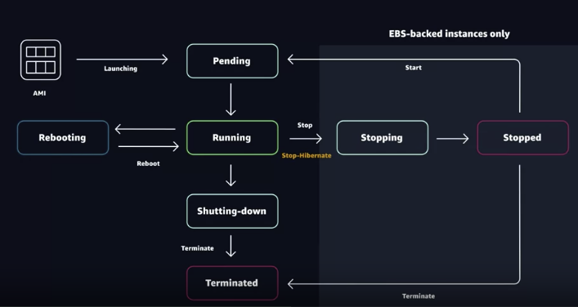
Amazon EC2 Instance Lifecycle
Different States from the moment that it is launched until termination. Start is AMI with State
Launching
  Pending State VM is booting up
  Running State Charged for the EC2 Instance
  Option States
    Rebooting
    Stopping – Stopped – ( Action: Start, State Pending )
    Stopping – Stopped – Hibernate Get charged in the Stopping State when hibernating
  Terminate – Shutting Down – Shut Down Once you terminate an instance it is gone.
Terminated instances remain visible in the AWS Management Console for some time after they have been terminated, but make no mistake they are deleted
  There is a feature called terminate protection that can be enabled.
Termination is good
  Save money
  For patching just start a new one with patch already applied to the system

Slide 28
Reading for EC2 instance
EC2 is a combination of:
  virtual processors
  memory
  network
  instance storage
  GPU
Instances Families
  General Purpose
  Compute Optimized compute bound applications that benefit from high performance processors
  Memory Optimized designed to deliver fast performance for workloads that process large data set in memroy
  Accelerated Computing Use hardware or co-processors to perform functions such as floating poing, graphics processing or ml
  Storage Optimized Designed for workloads thatre require high sequential read/write access to local datasets on local
  Deliver tens of thousands of low latency random I/O oeprations per second ( IOPS) to applications
  that replicate their data across different instances
Where does your EC2 Instance Live
  Default : EC2 instances are place in a network called the default Amazon Virtual Private Cloud
    Public and accessible by the internet

Slide 29
Reading for EC2 instance
What is the difference between Stop and Stop Hibernate
  Stop – The data stored in RAM is lost
  Stop-hibernate – The data contents of RAM is saved to the EBS root volume
What makes up pricing
  Once an instance is launched ( EC2) billing usually accrues on a per-second basic
    For 5 minutes and 38 second would be 338 second of utilization
    AMI’s form the AWS Marketplace have a billing of one hour
Reserved instances
  associated with an instance type and an availability zone
    discount is associated with an instance type
  provide with a significant discount compared to On-Demand instance pricing
    The hourly rate is discounted and an optional capacity reservation for EC2 instances
  Payment Options
    All upfront offer a higher discount than Partial Upfront instances
    Partial upfront instances offer a higher discount than no upfront
    No Upfront offers the lowest discount
When you choose On Demand you stop paying for the instance whey the instance is stopped or terminate the instance
When you choose RI you still pay for it because you committed to a 1-year or 3-year term

Slide 30
Reading for EC2 instance
Spot Instances
  Available up to 90%
  Can set a limit for how much you would like to pay for an hour
  May be interrupted if the capacity is no longer available or the price exceeds how much you are willing to pay
    Get a two minute warning before it interrupts your instance
  Workloads should be fault-tolerant
    Ex.
      big data
      containerized workloads
      CI/CD
      HPC
      image and media
      test and development workloads

Slide 31
Demonstration Exercise 3
EC2 Create/Launch/Terminate
To create an instance
  Provide Name
  Select AMI
  Select Instance Type
  Select/Create Key Pair ( ex. ssh ) – Optional
  Configure Network
    Default VPC/Subnet
      default VPC has an internet gateway
  Select an AMI Instance Profile
  User Data is where the bash script should go to run on launch
Select Launch Instance – 2 Steps Launch and run the initializtion

Slide 32
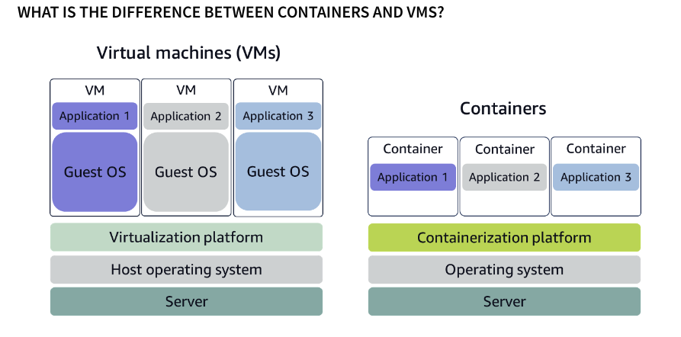
Container Services on AWS
Run containers at scale
Services – Both are orchestration tools
  Containers have short bootup times compared to
  virtual machines
  Run containers at scale
  Types
    Amazon Elastic Containers
    Amazon Elastic Kubernetes Service
Need processes to start/stop/restart/monitor containers running
across multiple EC2 instances
  collection of EC2 instances is a cluster
Fargate
  Use cases
    Don’t need to manage EC2 instances
    Don’t need access to the underlying OS
  Servless platform for ECS and EKS
1. Container are lightweight
2. Container spin up quick and almost instantly
a. Help to scale qucikly
3. virtual machines have a dedicated kernel

Slide 33
Container Services on AWS
Managing your compute at large scale
  How to place your containers on your instances
  What happens if the container fails
  What happens if your intance fails
  How to monitor deployment of your containers
Manage Containers with Amazon ECS
  End to End container orchestration service that quickly spins up
  up new containers and manage them across cluster of EC2 instances
  To run and manage your containers you need to install Amazon ECS container
  agent on your EC2 instances
    communicates about cluster management
  An instance with the container agen is called a container instance
Operations
  Launching
  Stopping
  Get Cluster State
  Scaling in/out
  scheduling the placement of container across the cluster
  assigning permissions
  meeting availability requirements

Slide 34
Container Services on AWS
To prepare your application to run on Amazon ECS you create a task definition
  A JSON File to describe one or more containers
  A blueprint containing : CPU, memory, ports, images, storage and networking information
Example
  {
  "family": "webserver",
  "containerDefinitions": [ {
  "name": "web",
  "image": "nginx",
  "memory": "100",
  "cpu": "99"
  } ],
  "requiresCompatibilities": [ "FARGATE" ],
  "networkMode": "awsvpc",
  "memory": "512",
  "cpu": "256”
  }

Slide 35
Container Services on AWS
Using Kubernetes with EKS
  An EC2 instance with ECS agent installed and configured --container instance
    In EKS called a worker node
  Task – An ECS Container is called a task in the EKS called a pod
  ECS run on AWS native technolgy and EKS runs on top of Kubernetes

Slide 36
Introduction to Servless
With ES2 you are responsible for setting patching, scaling and ensuring architectured your solutions to be hosted in a highly available manner
Servless
  Cannot observe or access the underlying infrastructure or instances that are hosting your solution
  All the management of the underlying environment rom a provisioning, scaling, fault tolerance and maintenance is done for you
    These tasks are abstracted from you
    Get to focus on the value that your application delivers
  Still responsible for Data Encryption and Access Management
  No severs to provision or manage
  Scales with usage
  Never page for idle resource
  Availability and Fault Tolerance are built in

Slide 37
Servless with AWS Fargate
ECS or EKS run clusters of containers on EC2
Fargate is a servelss for containers
  Define your Application Content, Network and Scaling
  Build Container Images and push them into Amazon ECR and AWS Fargate access them
  Support Spot and Compute Saving Plan
  Allocating the right compute, and handle clustering and scaling and provides workload isolatinoand oimproved security by design
Use Cases
  Microservices
  Batch Processing
  ML
  Migrating on premise apps to the cloud

Slide 38
Introduction to AWS Lambda
Servless Compute Option
  package and upload code (lambda function ) to the lamdba service.
  Run in response to triggers and then the lambda service run the lambda funciton
    Common triggers
      http request
      upload of a file
      events from AWS Service
    Code is run in an isolated environment managed by AWS Lambda
    Chose the language ( Run Time) , memory and cpu
  scales to meet the number of trigger that are happening
  The code show be able to complete in 15 minutes
  Only billed when you code is running and rounded up to a millisecond demo
  Can : Author from Scratch, Blueprint

Slide 39
Choosing the Right Compute Service
Tasked with creating a new feature for web application that hosted on EC2. The web app is an online store and all the items being sold are loaded into a database manually behind the scenes. This process takes a long time, isn't very scalable, and is prone to error. You are tasked with automating the process of getting the new item information loaded into the inventory database. The goal is to have a person upload an inventory spreadsheet into Amazon S3, the object storage service, then have a process automatically load the data into the inventory database. What compute would you use to host the processing logic to load the items from the file into the database?
  Questions you should ask : How often does data get upload Answer: once a month
  Amazon EC2 charges : cost per second, per hour spending money on useless ec2 cycles
  AWS Lamdba –
application currently hosted in your on-premises data center, which needs to be migrated to AWS. It's currently running on Linux servers in the data center, and you want to minimize the amount of refactoring needed to migrate to AWS. It's important that this workload is elastic and can support varying demand. What compute option would you choose?
  Use Amazon EC2 – Can use an Linux AMI and be hosted the same way as on premises
  Rework to migrate from an EC2 or Containers
write a brand-new application using a microservices or service-oriented design. And you want to architect the application where it can scale up or down quickly, and you want to lower the risk of deploying new changes to production. Which AWS compute service would you use?
  ECS or EKS
  Containers boot up quickly so it is quicker than scaling
  Containers behave the same way

